Slide 1
International Financial Accounting
Dr Sean Power, ACA

Slide 2
Session 4
Cash flow statement

Slide 3
Session 4: Cash flow statement
Introduction to cash flow statement
Statement of cash flows (IAS 7)

Slide 4
Introduction to cash flow statement

Slide 5
Statement of Cash Flows – Key Points
The Statement of Cash Flows provides supplementary information to the income statement
The income statement is prepared on an accrual basis
Captures the changes between two balance sheets
Provides more detail on increase in retained earnings for the year from operations
A measure of performance
The statement of cash flow is prepared on a cash basis
Captures the changes between a company’s cash resources between two balance sheet dates
A measure of performance
The income statement & cash flow statement provide complementary sources of information on an entity’s performance (see examples in next slides)

Slide 6
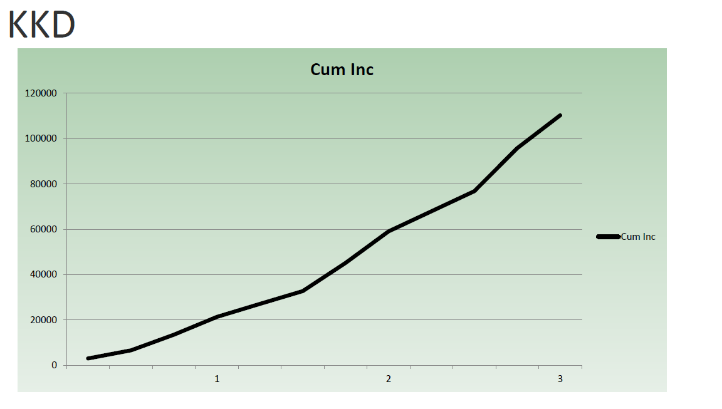
Graph of cumulative income for KKD

Slide 7
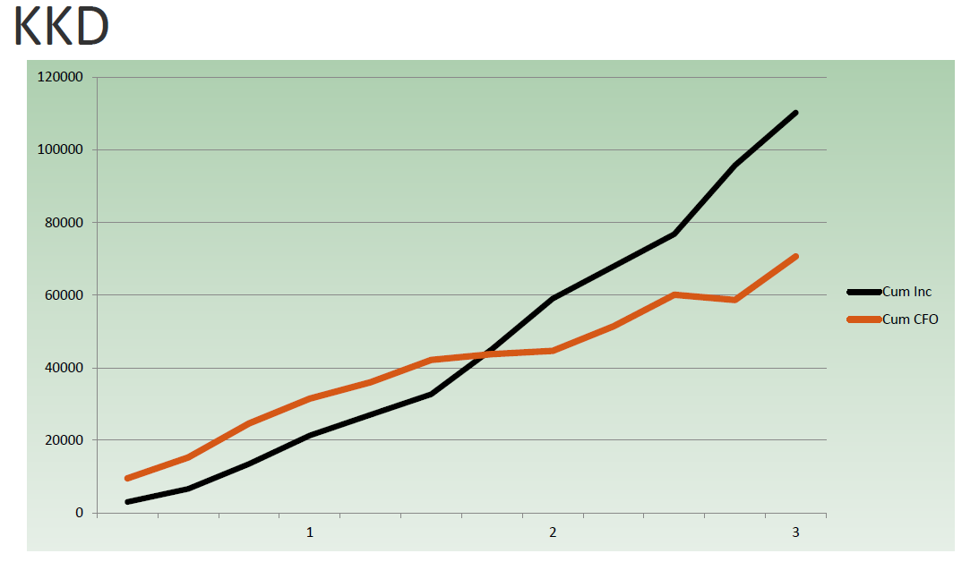
Graph of cumulative income and cumulative cash from operations for KKD

Slide 8
Overview
The purpose of the statement of cash flows is to:
Report cash receipts & cash payments over a period of time
Classify the cash flows as operating, investing & financing activities
Collectively exhaustive = there are 3 & only 3 categories. Everything must be classified as O, F or I
Mutually exclusive = if it is O then it cannot be F or I
Detail the changes in the cash account on balance sheet

Slide 9
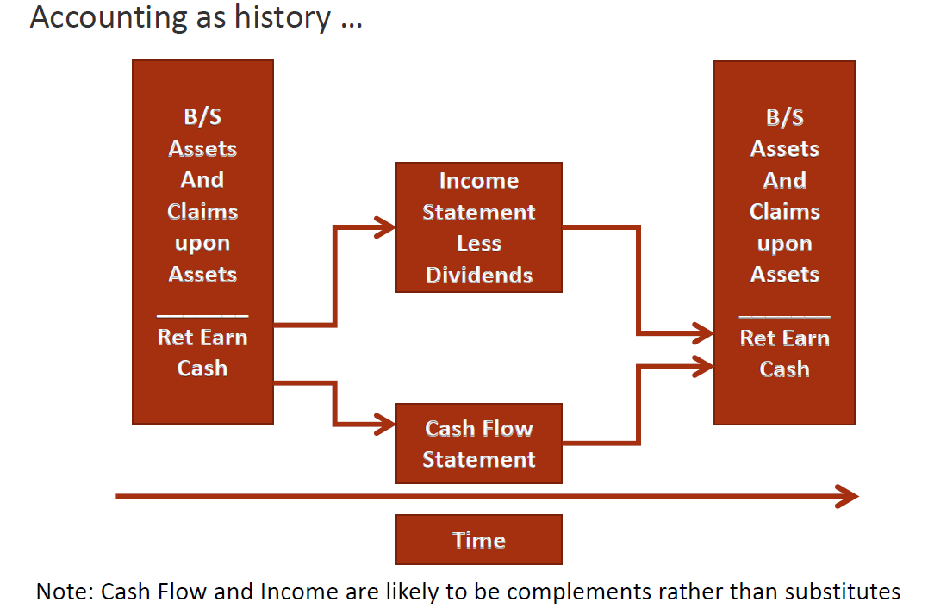
Articulation

Slide 10
Purpose of the Cash Flow Statement
A statement of cash flows:
Shows relationship of net income to change in cash balances (through the cash flow from operating activities section)
Helps to predict future cash flows
Evaluates how management generates & also uses cash
Determines a company’s ability to pay interest, dividends & debts when they are due
Identifies specific increases & decreases in a firm’s productive assets
The term “cash” also refers to cash equivalents:
Cash equivalents are highly liquid short-term investments that a company can easily and quickly convert to cash e.g.
Money market funds
Treasury bills

Slide 11
Typical Activities Affecting Cash
Managers affect cash by three types of decisions:
Operating decisions
Investing decisions
Financing decisions

Slide 12
Operating Activities
Operating decisions concerned with major day-to-day activities that generate revenues and expenses
Operating activities are transactions that affect the purchase, processing, and selling of a company’s products and services
Making sales
Collecting accounts receivable
Purchasing inventory
Paying accounts payable
The first major section on the statement of cash flows is labelled cash flows from operating activities

Slide 13
Investing Activities
Investing decisions include the choices to acquire or dispose of long-term productive assets or long-term investments
Investing activities are transactions that acquire or dispose of assets that are expected to provide services for more than one year
Purchasing or disposing of equipment
The investing section on the statement of cash flows is labelled cash flows from investing activities

Slide 14
Financing Activities
Financing decisions concerned with how to obtain or repay cash
Financing activities are a company’s transactions that obtain resources from debt & equity transactions
Issuance of additional share capital
Borrowing money from the bank
Repaying previous loans
The financing section on the statement of cash flows is labelled cash flows from financing activities

Slide 15
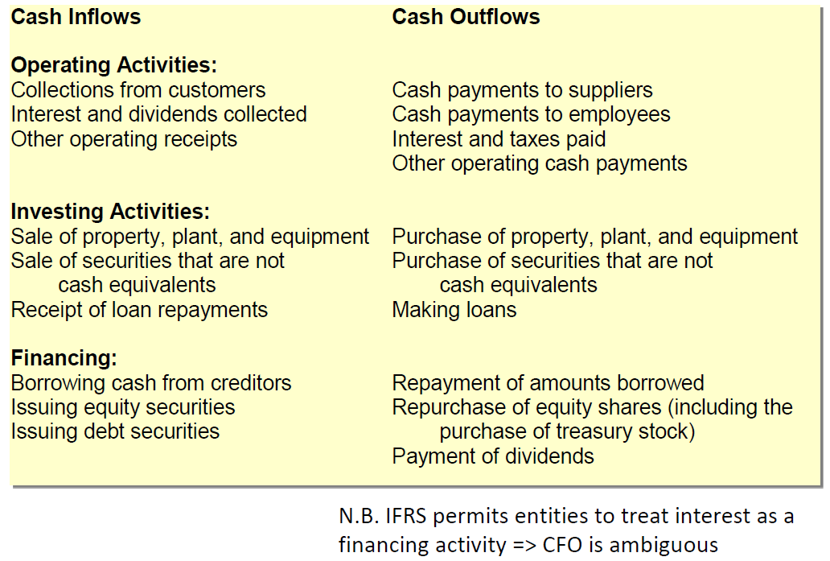
Typical Activities Affecting Cash

Slide 16
The importance of cash flow
The income statement matches revenue & expenses using accrual concepts & provides a measure of economic performance
The statement of cash flows explains changes in the cash account rather than owners’ equity
Free cash flow:
Finance measure of cash management performance
Refers to cash flows from operations less capital expenditures (& sometimes less dividends)

Slide 17
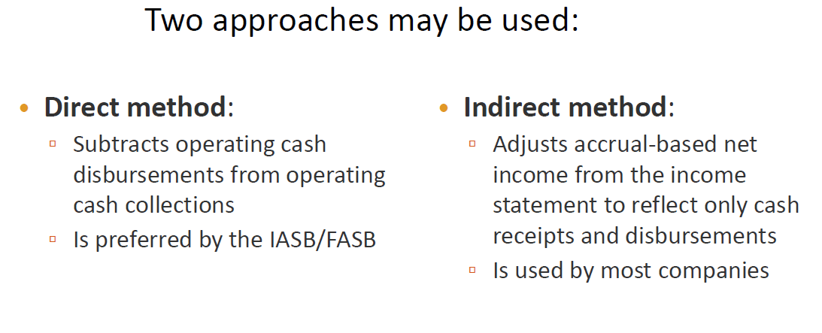
Cash Flow from Operating Activities

Slide 18
Reconciliation Statement
IASB & FASB require direct-method statements to include a supplementary schedule reconciling net income to net cash provided by operations
In other words, companies that use the direct method must also prepare a report using the indirect method (reconciliation schedule)
As a result, most companies use the indirect method

Slide 19
IFRS vs US GAAP
IFRS allows preparers to choose to include interest expense as either a financing activity or an operating activity
US GAAP requires interest expense to be an operating activity
Therefore, CFO not well defined under IFRS
Be careful of this difference, particularly if using CFO to derive a Free Cash Flow measure for a valuation model

Slide 20
Conclusions
Income & cash flow are describing many of the same economic events – hence they are complements
The statement of cash flows is a key financial statement and CFO may be computed as a residual or by using the direct or indirect methods
Free cash flow is widely used as a measure of cash generating ability
Be careful with CFO under IFRS as it may (or may not) include cash flows for interest

Slide 21
Cash Flow Statement: Google
KEY POINTS:
CFO is a laundry list of accrual-based adjustments that the accountant has put through the income statement
Can construct estimates of Free Cash Flow directly from cash flow statement
Why does Google hold so much cash ?

Slide 22
Statement of cash flows (IAS 7)

Slide 23
Important Definitions
“Cash”: Cash on hand and demand deposits
Bank borrowings generally deemed to be financing activities
However, when bank overdrafts are repayable on demand they form an integral part of an entity's cash management & therefore should be included as a component of cash and cash equivalents.
“Cash Equivalents”: Short-term highly liquid investments that are readily convertible to known amounts of cash & which are subject to insignificant risk of changes in value
Held for the purpose of meeting short-term cash commitments & not for investment purposes
An investment normally qualifies as a cash equivalent only when it is expected to mature within 3 months from the date of acquisition (NB: not from the end of the reporting period)

Slide 24
Presentation of Cash Flow Statement
All cash flows must be classified under one of 3 headings:
Operating activities
Investing activities
Financing activities
Note: A transaction could include cash flows that can be separated from classification into the above groups

Slide 25
1. Operating Activities
Cash flows from operating activities mainly derived from the principle revenue producing activities of an entity
They generally result from transactions & events which determine profit or loss
An entity has a choice in presenting cash flows from operating activities, it may either use:
Direct Method (use of this method encouraged by IAS 7)
OR
Indirect Method (we focus on this method for purposes of this module)
Notes:
Q: Which parts of the balance sheet fluctuate with Operating Activities?
A: Retained profit (income statement) & working capital (current assets & current liabilities)

Slide 26
The Direct Method
This method shows:
• Receipts from customers
• Payments to suppliers for goods and services
• Cash payments to and on behalf of employees

Slide 27
The Indirect Method
Under this method the net cash flow from operating activities determined by adjusting profit or loss by:
(a) Changes during the period in inventories, operating receivables & operating payables;
(b) Non-cash items in income statement
e.g. depreciation, gains/losses on disposal of non-current assets, provisions, unrealised foreign currency gains and losses and undistributed profits of associates and non-controlling interest

Slide 28
2. Investing Activities
They are defined as the acquisition and disposal of long-term assets and other investments not included in cash equivalents.
Examples:
(a) Cash payments to acquire property, plant and equipment, intangibles and other long-term assets.
(b) Cash receipts from sale of property, plant and equipment, intangibles and other long-term assets.
(c) Payments to acquire equity or debt instruments in other entities (including associates) held as assets – N.B. do not include those instruments which qualify as cash equivalents.
(d) Cash receipts from selling investments in other entities as in (c).
(e) Cash advances and loans to other parties and cash receipts from repayment of those advances and loans.
Notes:
Q: Which parts of the balance sheet fluctuate with Investing Activities?
A: Non-current assets – which reflect long-term productive capacity of the firm

Slide 29
3. Financing Activities
Those activities that result in changes in size & composition of the contributed equity & borrowings of an entity
Examples:
(a) Cash proceeds from the issue of shares or other equity instruments
(b) Cash payments to acquire or redeem the entity's shares
(c) Cash receipts from the issue of:
Debentures
Loans
Short or long-term borrowings
Bonds, etc.
(d) Cash repayments of amounts borrowed
(e) Capital portion of a finance lease rental payment
Notes:
Q: Which parts of the balance sheet fluctuate with Investing Activities?
A: Equity & non-current liabilities (which tends to reflect debt)

Slide 30
Reporting Cash Flows from Investing & Financing Activities
General Rule:
Entities must report separately major classes of gross cash receipts and gross cash payments

Slide 31
Treatment of Interest & Dividends
Cash flows from interest & dividends received & paid must each be disclosed separately
Each must be classified in a consistent manner from period to period
However, lAS 7 is not prescriptive in the treatment of interest and dividends

Slide 32
Treatment of Interest & Dividends
Interest Paid, Interest Received & Dividend Received:
Interest paid/received & dividends received may be classified as OPERATING cash flows because they are included in the calculation of profit or loss
OR
May be included under FINANCING activities & INVESTING activities because they are costs of obtaining financial resources or returns on investments
Notes:
This differences may be important / material – keep an eye out for them in your group project

Slide 33
Treatment of Interest & Dividends
Dividend Paid:
Dividends paid may be classified as a FINANCING cash flow - a cost of obtaining financial resources
OR
Can be included as a component of OPERATING cash flows in order to assist users of financial statements to determine the ability of the reporting entity to pay dividends out of operating cash flows.
Notes:
This differences may be important / material – keep an eye out for them in your group project

